Slide 1

Application: Jobster
Type: Application Architecture
View: Logical View
Style: Layered Architecture Pattern
Core Business Processes
Data and Information
Technology Enablers
User
Delivery Channel
Home
(Basic search
& sign in/up)
Login Data
Cloud
Customers/Partner Data
Payment Getaway
Customize User/Partner Account
Jobs Data
Customers
E-mail Services
Web App
Customize User Account & Payments
Filtering Data
Real-time Bus
Job Application Data
Partner Dashboard
Tickets for Help Desk
Partners
Transactions
Help Desk
Subscription Information
Job Search API
Internet
Advance Search
Contact Form Data
Admin

Slide 2


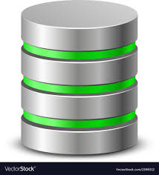



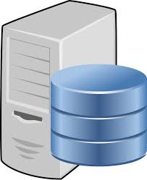
Application: Jobster
Type: Application Architecture
View: Process View
Style: Layered Architecture Pattern
Application: Jobster
Type: Application Architecture
View: Logical View
Style: Layered Architecture Pattern
DMZ
Core
Secure Core
Customers
Web App
Web browser authenticates customers/partners
Admin
NAS & Storage
Monitor activities
Partners
Web Server
Authorizing users/partners
Handling exceptions
Secure configuration
Make business logic calculations
Internet
DB Server
App Server

Slide 3







Application: Jobster
Type: Application Architecture
View: Physical View
Style: Layered Architecture Pattern
Cisco ASA5506-K9
Firewall
Internet
Firewall
External Layer
Cisco ASA5506-K9
Firewall
Web Application Layer
Cisco ASA5506-K9
Firewall
Firewall
Firewall
Internal Layer
Asus RT-AX88U
Router
Router
SQL Database Server
Workstations
Asus RT-AC66U B1
Router
Router
MacBook/PC
HP X3 Web
App server
Employees
Client’s Web Browser
APACHE
Web server
App Server
Web Server

